Slide 1


BONE FRACTURE CLASSIFICATION FROM
X-RAY IMAGES
USING MACHINE LEARNING
AML MINI PROJECT
20ALT44 - APPLIED MACHINE LEARNING
Mohamed Bilal Z H [21ALR027], Sukesh S [21ALR048],
Yokeswaran [21ALR056]
Department of AI
Kongu Engineering College, Perundurai
Dr.K.S.Kalaivani
Assistant Professor (SrG) – Department of AI

Slide 2
Outline
Problem Statement
Objectives
Introduction
Literature Survey
Methodology
Performance Evaluation
Conclusion
References

Slide 3
Problem Statement
The problem addressed in this study is the classification of bone fractures from X-ray images using machine learning
The accurate and timely classification of fractures is crucial for effective diagnosis and treatment planning in the field of orthopedics.
Traditional methods of fracture classification heavily rely on human expertise, which can be time-consuming and subjective.
Therefore, there is a need to develop a machine learning-based approach that can automate the fracture classification process, providing a reliable and efficient solution.

Slide 4
Objectives
Develop a machine learning model capable of accurately classifying bone fractures from X-ray images.
Investigate different machine learning algorithms suitable for fracture classification and evaluate their performance.
Explore feature extraction techniques to capture relevant information from X-ray images.
Compare the performance of different algorithms and select the most effective one for bone fracture classification.
Provide a comprehensive evaluation of the proposed approach using appropriate performance metrics.
Discuss the limitations and potential future directions for improving fracture classification using machine learning

Slide 5
Introduction
The introduction section will provide an overview of the significance of accurate fracture classification in orthopedics. It will highlight the limitations of existing manual methods and the potential benefits of using machine learning for automated classification.
The section will also outline the objectives and structure of the study.

Slide 6
Literature Survey
S.NO | TITLE OF THE PAPER | NAME OF THE AUTHORS | ALGORITHM USED
1. | GLCM Based Feature Extraction and Medical XRAY Image Classification using Machine Learning Techniques | Pawan Kumar Mall Department of Computer Science & Engineering Madan Mohan Malaviya University. | LBF SVM, Linear SVM, logistic regression and decision tree.
2. | Machine learning framework for image classification | Loussaief, Sehla, and Afef Abdelkrim | KNN, SVM, SURF
3. | Research on medical image classification using machine learning. | Hai Tang and Zhihui Hu School of Electrical and Information Engineering. China. | CNN, RBF-SVM, PCA-CNN, CNN-SVM.
4. | Comparative analysis of image classification algorithms based on traditional machine learning and deep learning | Wang, Pin, En Fan, and Peng Wang | Support Vector Machine, CNN, Deep Learning

Slide 7
Methodology
The Image dataset used for this process has been downloaded from Kaggle. It contains a total of 9463 images which of two classes Fractured and Not Fractured.
Data Pre-processing
Since the dataset is in the form of Image, it is converted into array [or] Vectors.
To scale the data, MaxAbsScaler is implemented
Hyperparamter Tuning
The experiments are conducted using Machine Learning model, instead of CNN, the model should be at its optimal level.
So, Implementing Hyperparameter Tuning it can be achieved

Slide 8
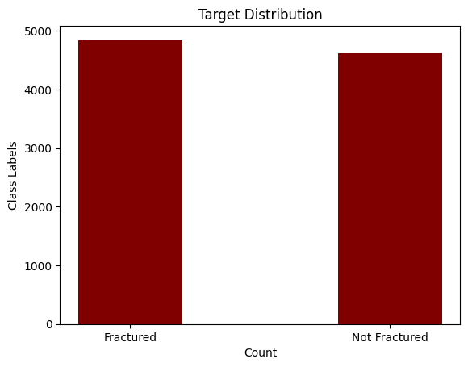
Fig1. Data Analysis
The aforementioned figures can be used to determine the distribution of the class labels in the Image Dataset.

Slide 9
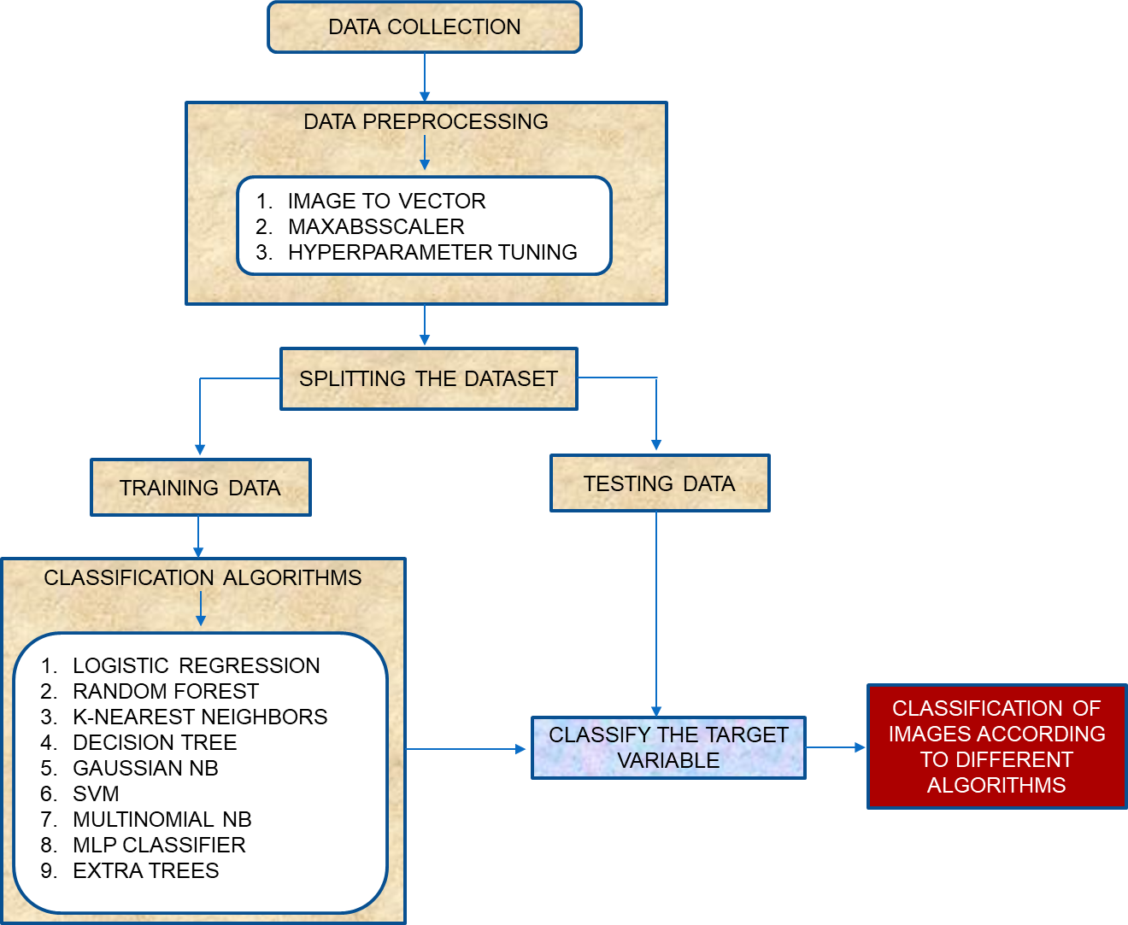
3. Proposed Model
The above mentioned algorithms and the model results are evaluated

Slide 10
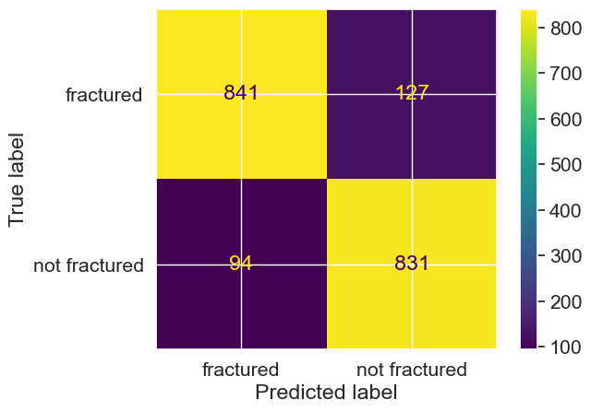
Performance Evaluation
The models can be evaluated using Confusion Matrix and Classification Report. The model evaluation is depicted below
1. Logistic Regression
Logistic Regression is an example of supervised learning. It is used to calculate or predict the probability of a binary (yes/no) event occurring. The parameters of a logistic regression are most commonly estimated by maximum-likelihood estimation (MLE).

Slide 11
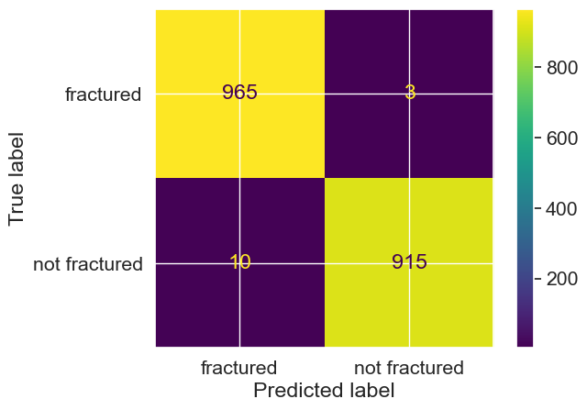
2. Random Forest
Random forest is a commonly-used machine learning algorithm trademarked by Leo Breiman and Adele Cutler, which combines the output of multiple decision trees to reach a single result. Its ease of use and flexibility have fueled its adoption, as it handles both classification and regression problems.
3. K-Nearest Neighbors
The k-Nearest Neighbors algorithm, also known as KNN or K-NN, is a non-parametric, supervised learning classifier, which uses proximity to make classifications or predictions about the grouping of an individual data point.

Slide 12


4. Decision Tree
A Decision Tree is a non-parametric supervised learning algorithm, which is utilized for both classification and regression tasks. It has a hierarchical, tree structure, which consists of a root node, branches, internal nodes and leaf nodes.

Slide 13
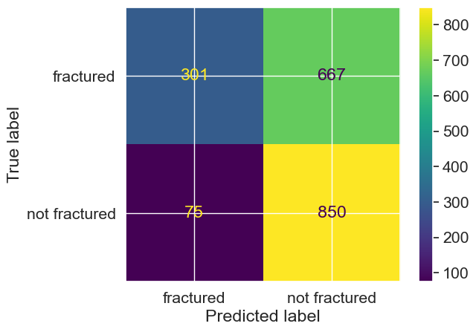
5. Gaussian NB
Gaussian Naive Bayes (GNB) is a classification technique used in Machine Learning (ML) based on the probabilistic approach and Gaussian distribution. Gaussian Naive Bayes assumes that each parameter (also called features or predictors) has an independent capacity of predicting the output variable.
6. Support Vector Machine
A Support Vector Machine (SVM) is a type of deep learning algorithm that performs supervised learning for classification or regression of data groups. In AI and machine learning, supervised learning systems provide both input and desired output data, which are labelled for classification.

Slide 14
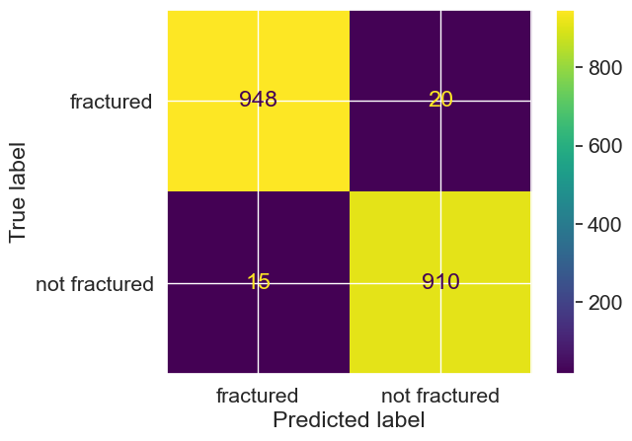
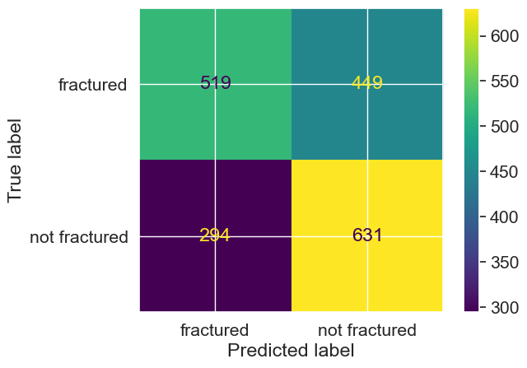
7. Multinomial NB
Multinomial Naive Bayes algorithm is a probabilistic learning method that is mostly used in Natural Language Processing (NLP). The algorithm is based on the Bayes theorem and predicts the tag of a text such as a piece of email or newspaper article.

Slide 15
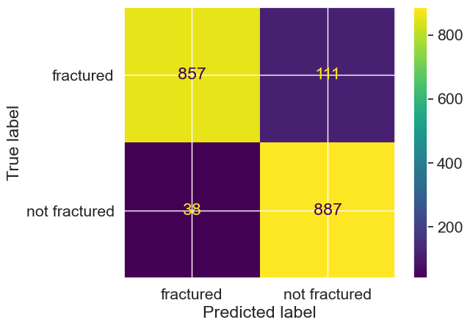
8. Multi-Layer Perceptron Classifier
A multilayer perceptron is a neural network connecting multiple layers in a directed graph, which means that the signal path through the nodes only goes one way. Each node, apart from the input nodes, has a nonlinear activation function.
9. Extra Tree
Extra trees is an ensemble supervised machine learning method that uses decision trees and is used by the Train Using AutoML tool. See Decision trees classification and regression algorithm for information about how decision trees work.

Slide 16


Slide 17
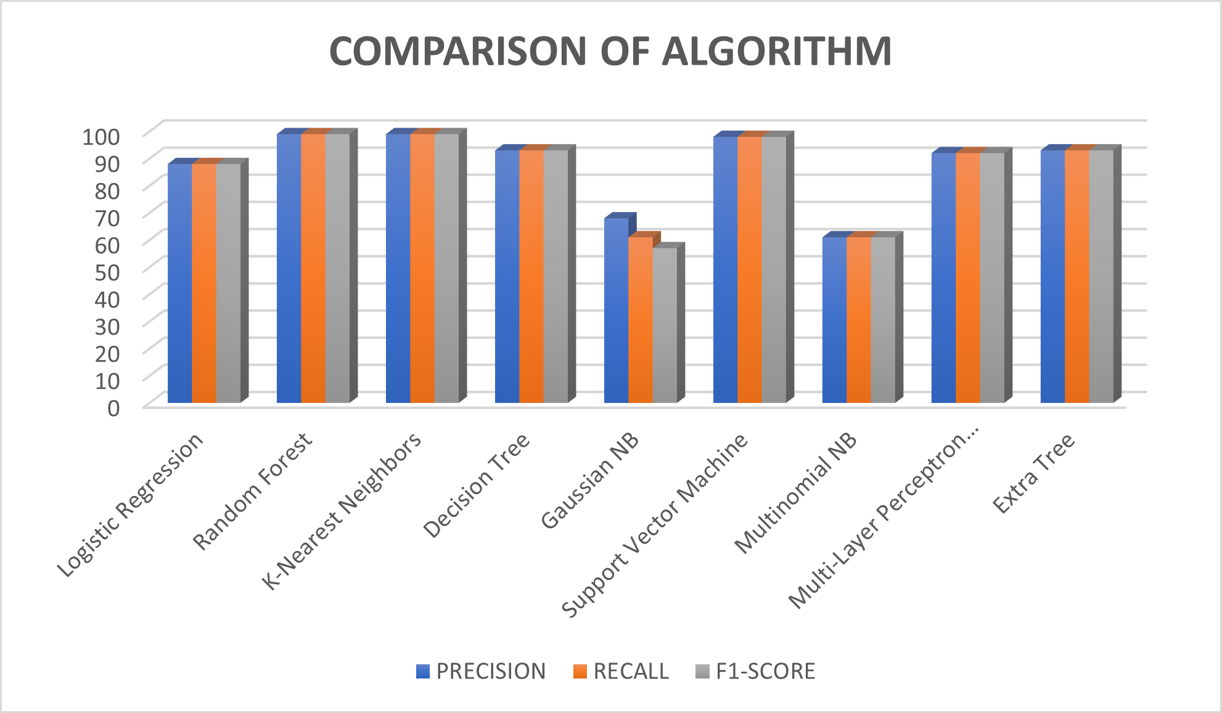
Fig2. Visualization of Classification Report

Slide 18
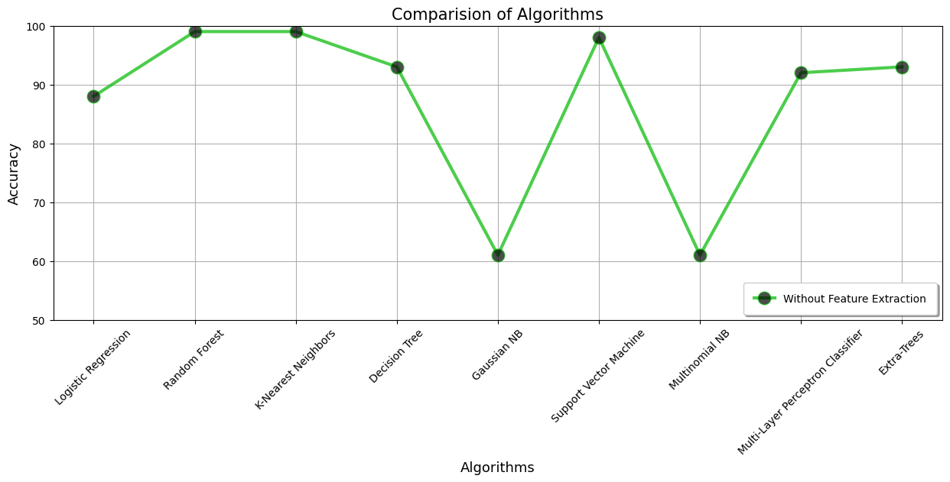
Fig 3. Comparison between Accuracy of the algorithms.
As seen in Fig. 3, both Random Forest and K-Nearest Neighbors produce better accuracy compared to other algorithms

Slide 19
Conclusion
The conclusion section will summarize the findings of the study and discuss the effectiveness of the proposed machine learning approach for bone fracture classification.
It will highlight the contributions, limitations, and future directions for further improvement.
According to the experiments, it can be concluded that the Random Forest and K-Nearest Neighbors provide 99% accuracy and it’s the optimal among other models.

Slide 20
References
1. Mall, Pawan Kumar, Pradeep Kumar Singh, and Divakar Yadav. "Glcm based feature extraction and medical x-ray image classification using machine learning techniques." 2019 IEEE Conference on Information and Communication Technology. IEEE, 2019.
2. Loussaief, Sehla, and Afef Abdelkrim. "Machine learning framework for image classification." 2016 7th International Conference on Sciences of Electronics, Technologies of Information and Telecommunications (SETIT). IEEE, 2016.
3. Tang, Hai, and Zhihui Hu. "Research on medical image classification based on machine learning." IEEE access 8 (2020): 93145-93154.
4. Wang, Pin, En Fan, and Peng Wang. "Comparative analysis of image classification algorithms based on traditional machine learning and deep learning." Pattern Recognition Letters 141 (2021): 61-67.
5. Anand, R., et al. "Extended morphological profiles analysis of airborne hyperspectral image classification using machine learning algorithms." International Journal of Intelligent Networks 2 (2021): 1-6.

